Slide 1
Level 6 Group 3 : Pitch Presentation
Presented on 11/10/2017
River Chick
Michael Curtis
Ryan Manthorp
Ogheneochuko Ideh

Slide 2
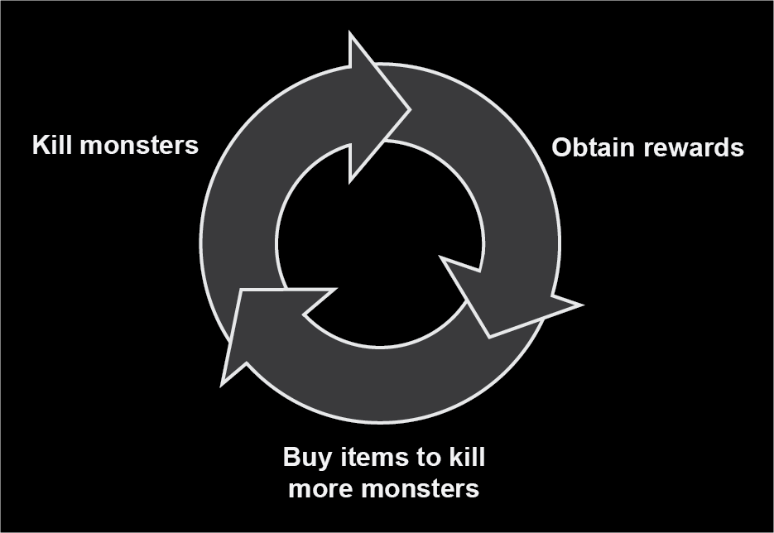
What is our brief?
Player retention is a key skill for game designers.
This is achieved through compulsion loops.
Our brief is to harness and showcase the ability of compulsion loops.
Figure 1

Slide 3
Our task
Create an experience showcasing one or more compulsion loops.
Effectively encourage player retention.
The experience must feature identifiable:
Triggers
Player actions
Variable rewards
A suitable player investment. (Eyal,2014)

Slide 4
Restrictions
No embargo on themes and motifs.
The game must be targeted towards a casual demographic.
UI must be clear & easy to navigate.
Clear affordances.
Suitable to be player able over weeks and even months.

Slide 5
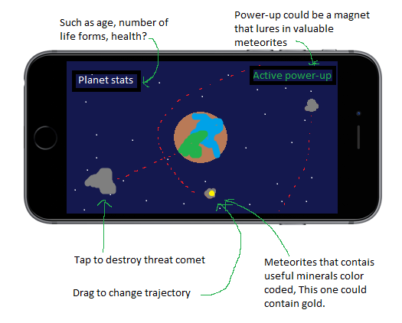
Planetary V-PET SUMULATOR CONCEPT
Figure 2

Slide 6
Title
Bullet points.

Slide 7
Title
Bullet points.

Slide 8
Title
Bullet points.

Slide 9
Title
Bullet points.

Slide 10
Title
Bullet points.

Slide 11
Early concept work and Prototype
Include concept art and video footage.

Slide 12
Managerial colony game concept
Insert concept art or any related imagery.
Figure 3

Slide 13
Title
Bullet points.

Slide 14
Title
Bullet points.

Slide 15
Title
Bullet points.

Slide 16
Title
Bullet points.

Slide 17
Title
Bullet points.

Slide 18
Early concept work and Prototype
Include concept art and video footage.

Slide 19
Plant Clicker game
Insert concept art or any related imagery.
Figure 4

Slide 20
Title
Bullet points.

Slide 21
Title
Bullet points.

Slide 22
Title
Bullet points.

Slide 23
Title
Bullet points.

Slide 24
Title
Bullet points.

Slide 25
Early concept work and Prototype
Include concept art and video footage.

Slide 26
Thank you for your time, questions?

Slide 27
bibliography
Figure one:
Mark A Hart . (2013). Developing the Conditions for Better Compulsion Loops in New Product Development. Available: http://oplaunch.com/blog/tag/core-compulsion-loop/. Last accessed 09/10/2017.
Eyal, N. and Hoover, R. (n.d.). Hooked.

